Slide 1


Analysing Amazon Sales Data
Name:- LOKESH MADURU
LinkedIn:- www.linkedin.com/in/lokeshmaduru

Slide 2
Aim of the Project:-
The major aim of this project is to gain insight into the sales data of Amazon to understand the different factors that affect sales of the different branches
Approach Used:-
Data Wrangling
  Build a database
  Create a table and insert the data.
  Select columns with null values in them
Future Engineering
  Adding new column named “timeofday”
  Adding new column named “dayname”
  Adding new column named “monthname”
Exploratory Data Analysis
  Answering Questions

Slide 3

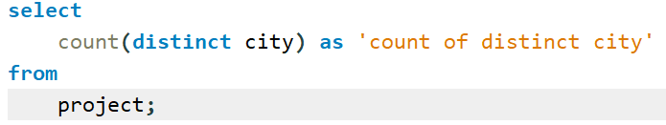
1.What is the count of distinct cities in the dataset?

Slide 4
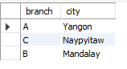
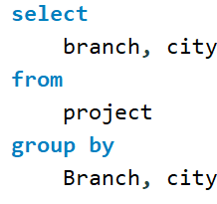
2.For each branch, what is the corresponding city?

Slide 5
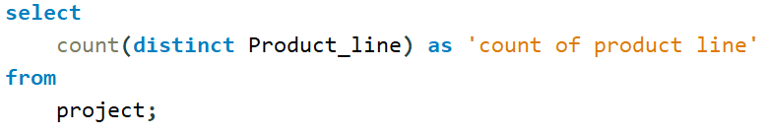

3.What is the count of distinct product lines in the dataset?

Slide 6

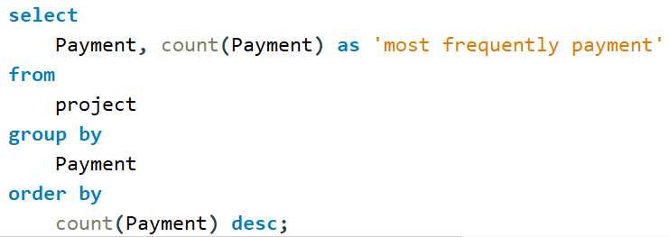
4.Which payment method occurs most frequently?

Slide 7
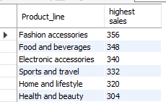
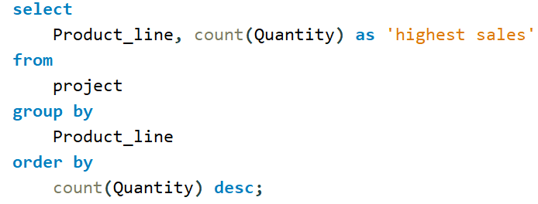
5.Which product line has the highest sales?

Slide 8

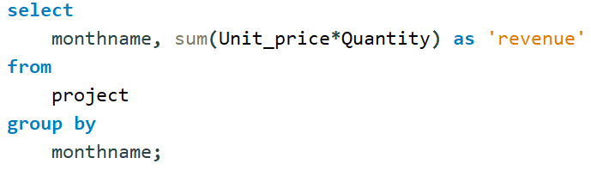
6.How much revenue is generated each month?

Slide 9

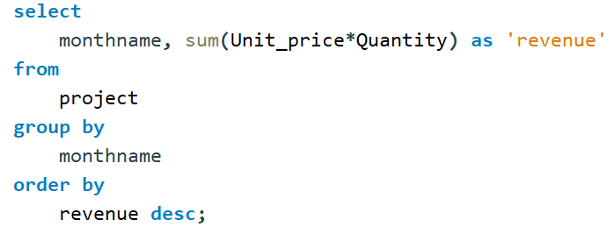
7.In which month did the cost of goods sold reach its peak?

Slide 10
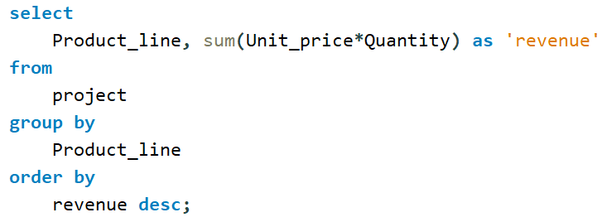
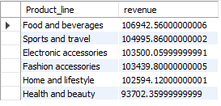
8.Which product line generated the highest revenue?

Slide 11
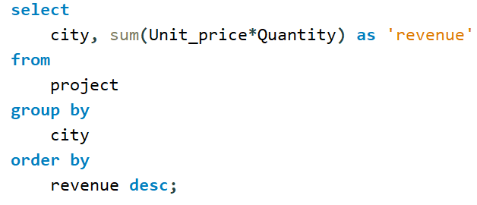

9.In which city was the highest revenue recorded?

Slide 12
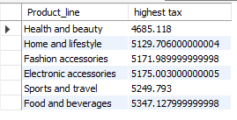
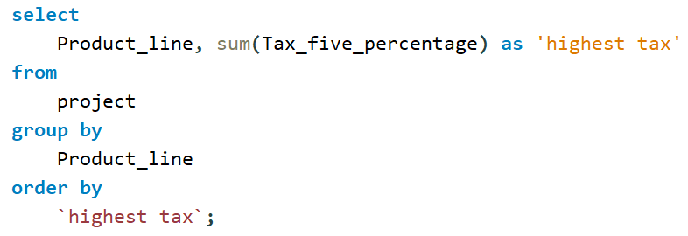
10.Which product line incurred the highest Value Added Tax?

Slide 13
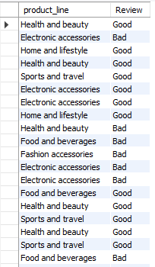
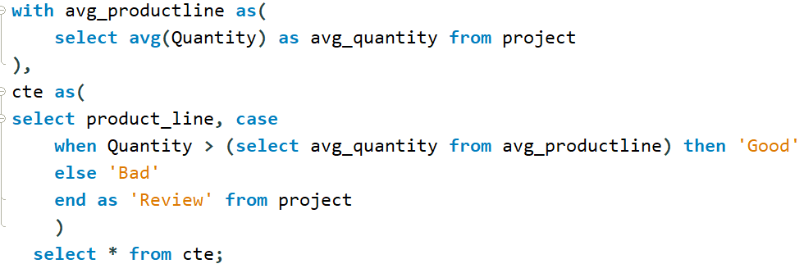
11.For each product line, add a column indicating "Good" if its sales are above average, otherwise "Bad.“?

Slide 14
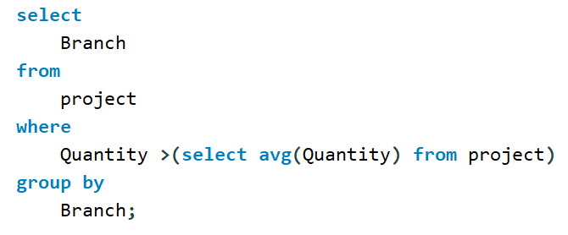

12.Identify the branch that exceeded the average number of products sold.

Slide 15
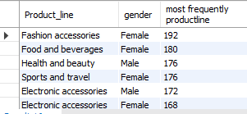
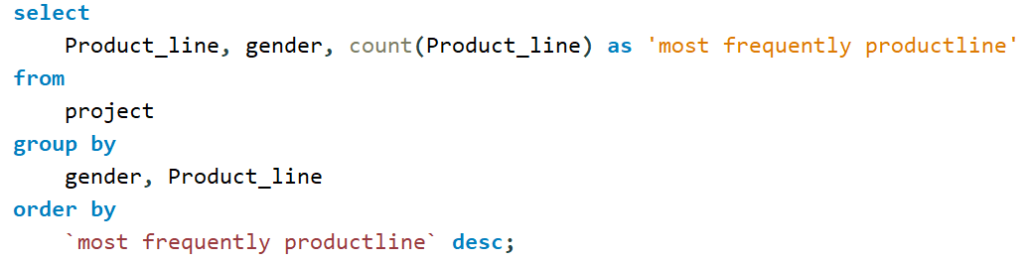
13.Which product line is most frequently associated with each gender?

Slide 16
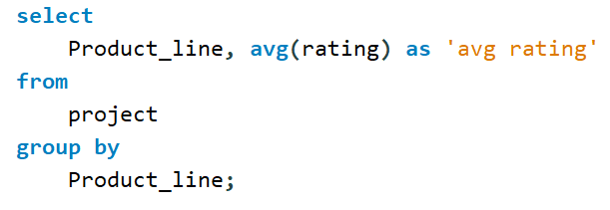
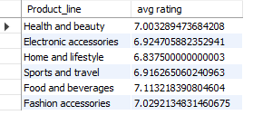
14.Calculate the average rating for each product line ?

Slide 17
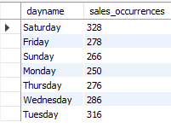
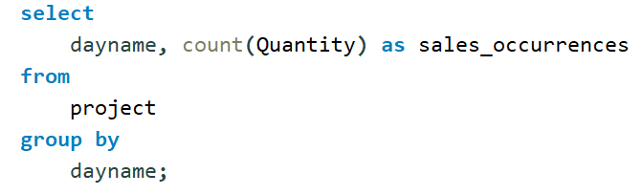
15.Count the sales occurrences for each time of day on every weekday.

Slide 18
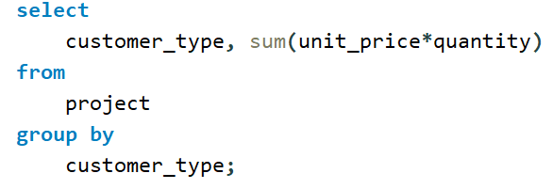

16.Identify the customer type contributing the highest revenue?

Slide 19
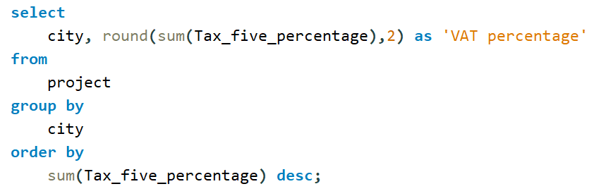

17.Determine the city with the highest VAT percentage?

Slide 20
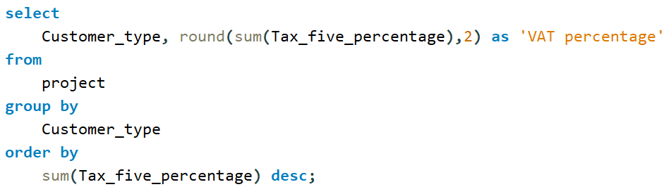

18.Identify the customer type with the highest VAT payments?

Slide 21
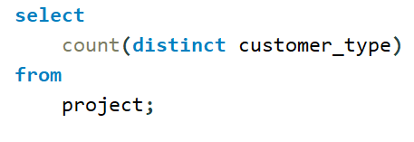

19. What is the count of distinct customer types in the dataset?

Slide 22
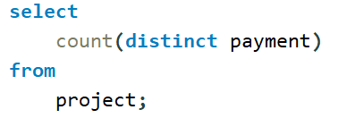

20. What is the count of distinct payment methods in the dataset?

Slide 23
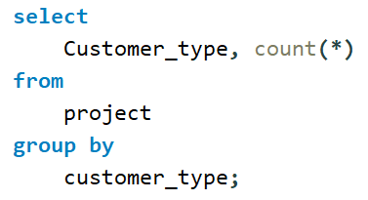

21.Which customer type occurs most frequently?

Slide 24
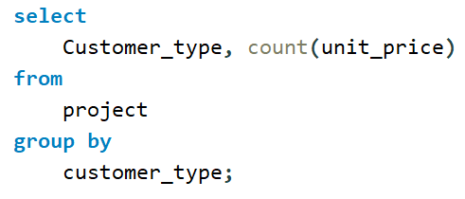

22. Identify the customer type with the highest purchase frequency.

Slide 25
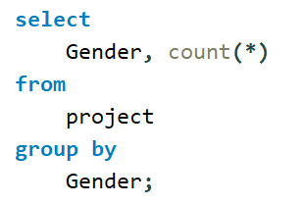

23. Determine the predominant gender among customers?

Slide 26
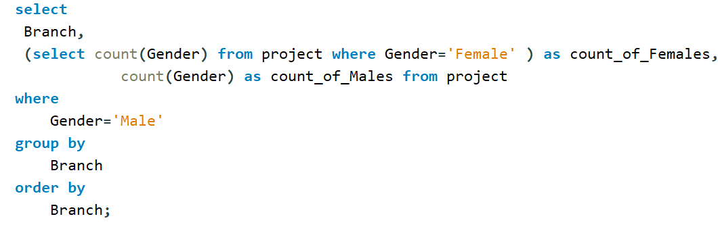

24.Examine the distribution of genders within each branch?

Slide 27
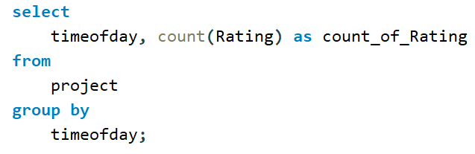

25.Identify the time of day when customers provide the most ratings?

Slide 28
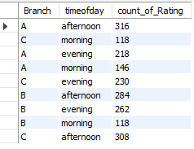
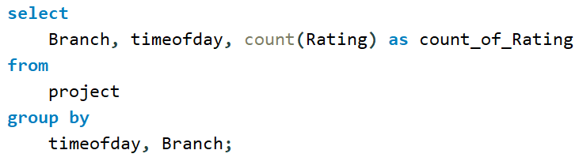
26.Determine the time of day with the highest customer ratings for each branch.

Slide 29
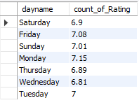
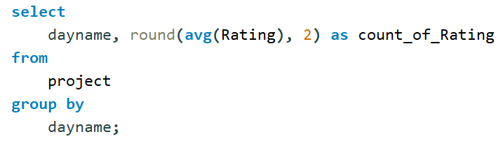
27.Identify the day of the week with the highest average ratings?

Slide 30
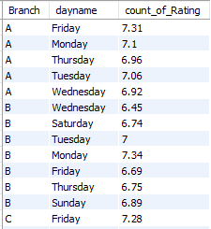
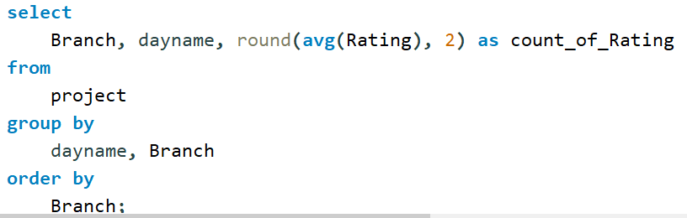
28. Determine the day of the week with the highest average ratings for each branch.

